Slide 1

ArtisanNexus
Juan David Olmos Corredor - 20202020004
Jorge Andrés Quiceno Sanabria - 20172020088
Laurent David Chaverra Córdoba - 20171020082

Slide 2

Problem
There are currently hundreds of e-commerce platforms, but these are focused on a global scale, and it is very difficult for SMEs to stand out competitively in such an environment.

Slide 3
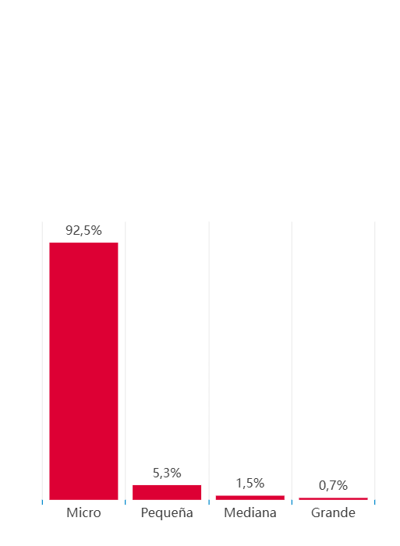
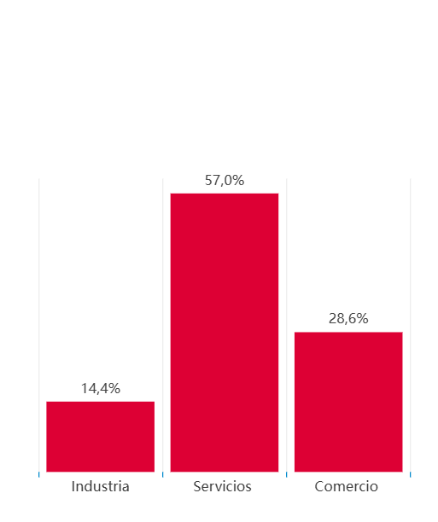
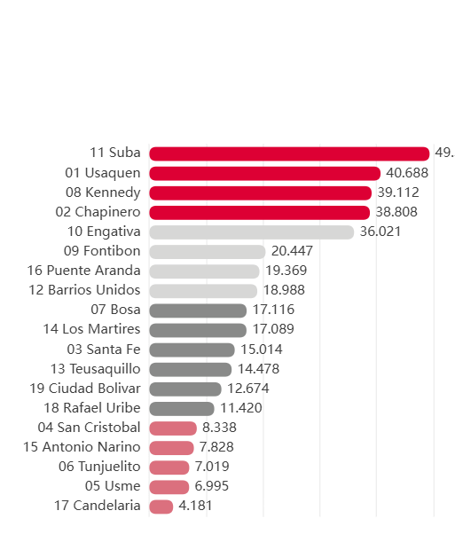
Demand
In 2024, in the 3 nearest municipalities to the university (Usaquen, Chapinero, and Santa Fe), around 20,000 commercial companies were registered alone.
Percentage of enterprises per size in 2024
Percentage of enterprises per economy sector in 2024
Percentage of enterprises in 2024

Slide 4

Solution
So we considered that the existence of local e-commerce, which incentivized the local economy, was necessary. And this is exactly what we propose: a local e-commerce platform that helps to develop the local economy, developed by and for Colombians.

Slide 5
Value proposition
Present an attractive alternative for SMEs to enter the digital market, while encouraging user purchases through an adaptive recommendation system.

